Slide 1
Filter
B11107019 張鈺林
B11107048 李勁磊
B11107043 彭成任

Slide 2
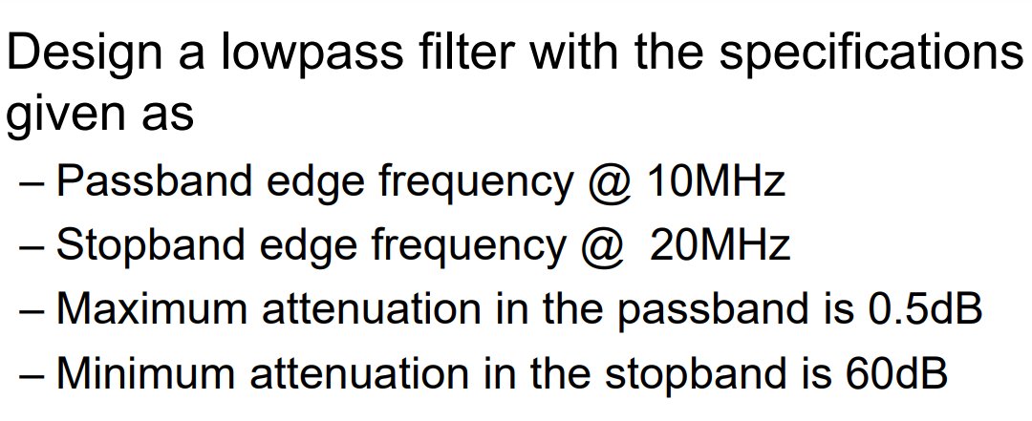
Specification

Slide 3
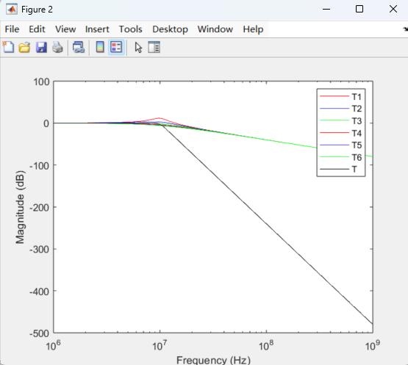
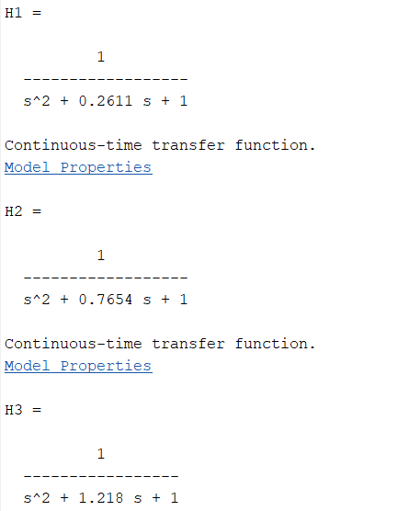
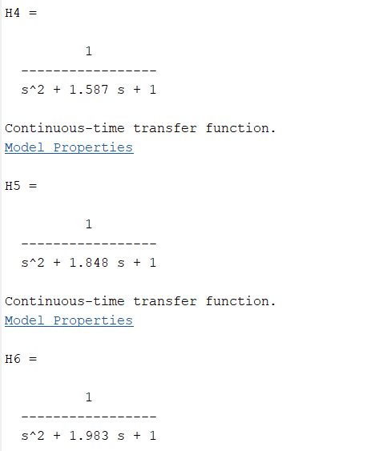
Matlab
Waveform
Transfer function

Slide 4
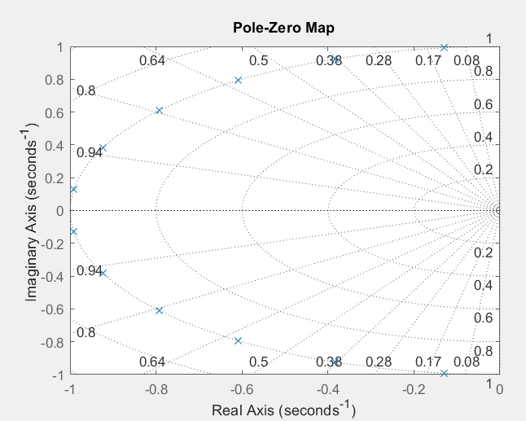

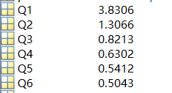
Matlab
N=12
Pole
Q and N parameter

Slide 5
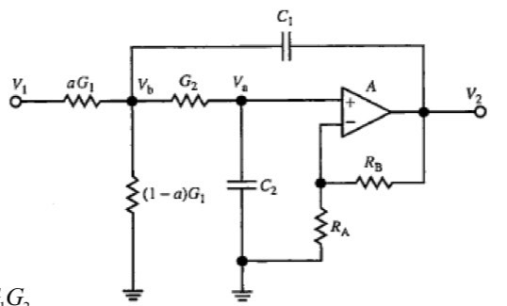
Circuit design(Sallen-Key Biquad)

Slide 6
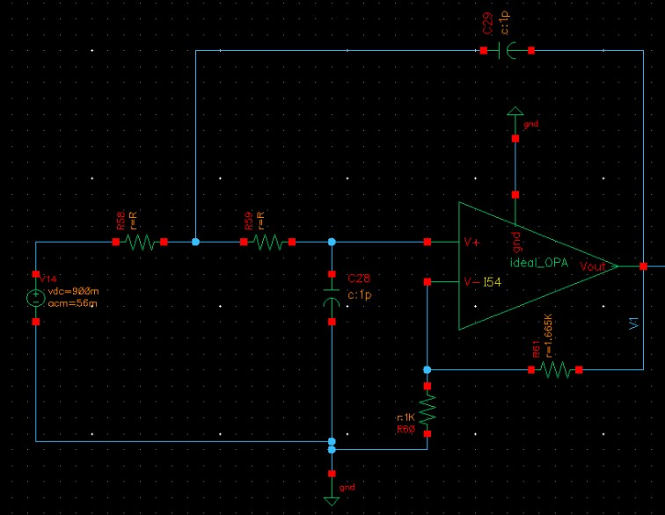
Schematic (Sallen-Key1)
R1=R2=18.87kΩ、C1=C2=1pF
RA=1kΩ、RB1=1.665kΩ

Slide 7
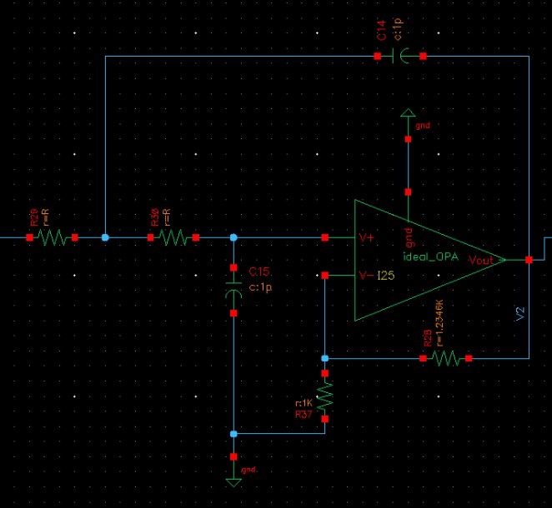
Schematic (Sallen-Key2)
R1=R2=18.87kΩ、C1=C2=1pF
RA=1kΩ、RB2=1.2346kΩ

Slide 8
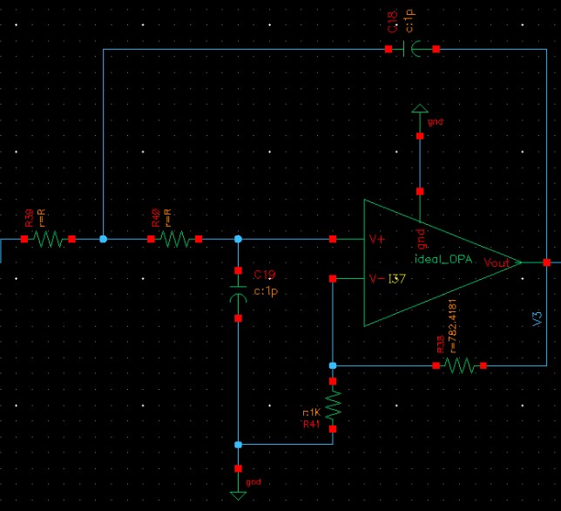
Schematic (Sallen-Key3)
R1=R2=18.87kΩ、C1=C2=1pF
RA=1kΩ、 RB3=782Ω

Slide 9
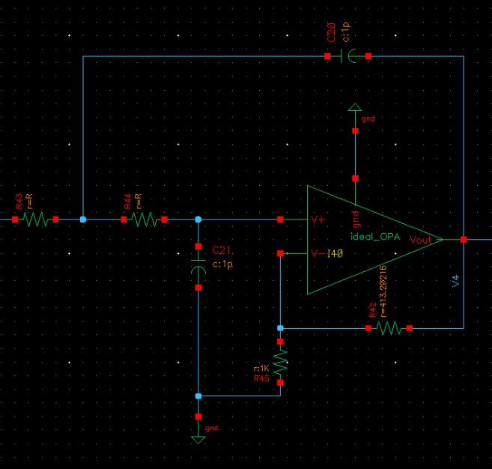
Schematic (Sallen-Key4)
R1=R2=18.87kΩ、C1=C2=1pF
RA=1kΩ、 RB4=413Ω

Slide 10
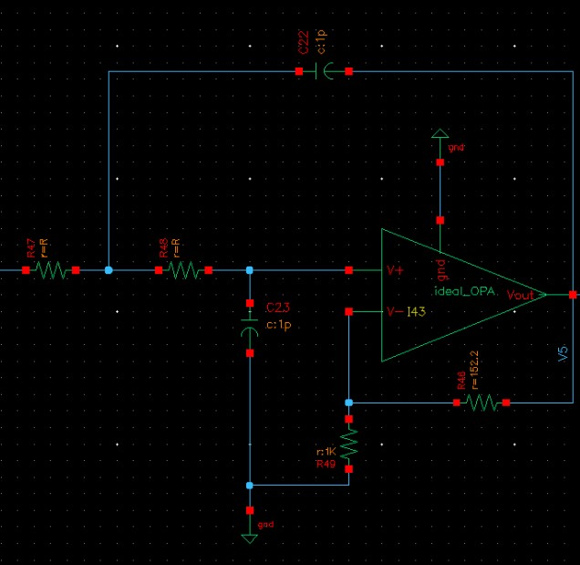
Schematic (Sallen-Key5)
R1=R2=18.87kΩ、C1=C2=1pF
RA=1kΩ、 RB5=152.2Ω

Slide 11
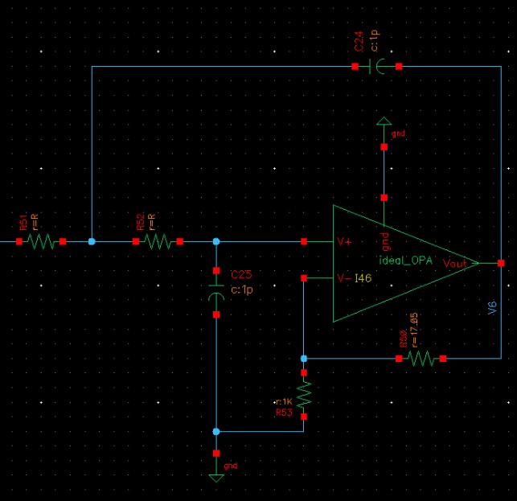
Schematic (Sallen-Key6)
R1=R2=18.87kΩ、C1=C2=1pF
RA=1kΩ、RB6=17.05Ω

Slide 12
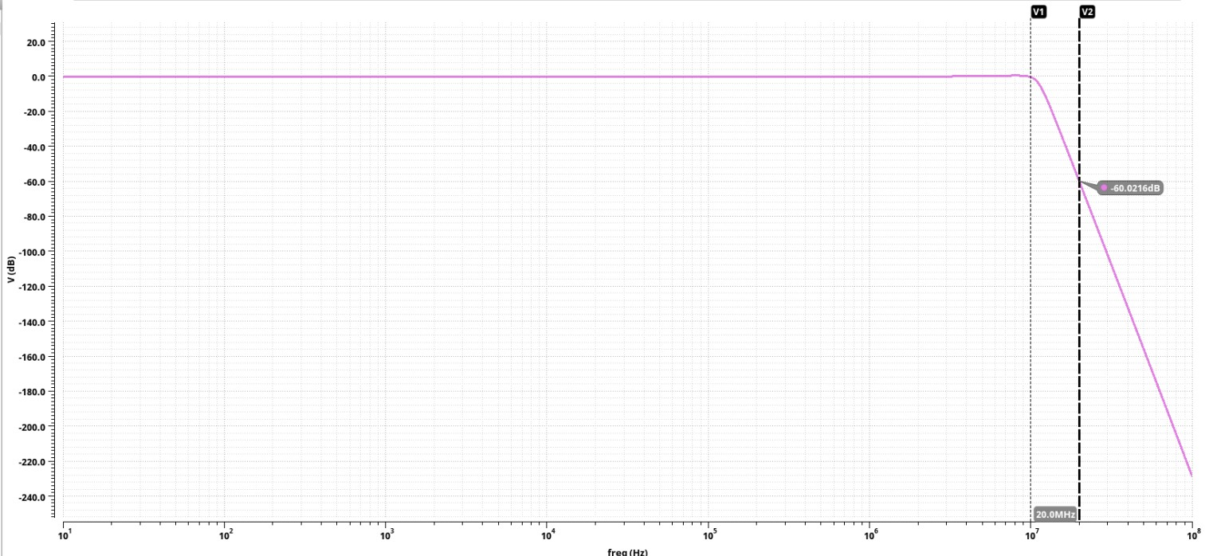
Waveform(α_{min}=-60.0216dB)

Slide 13
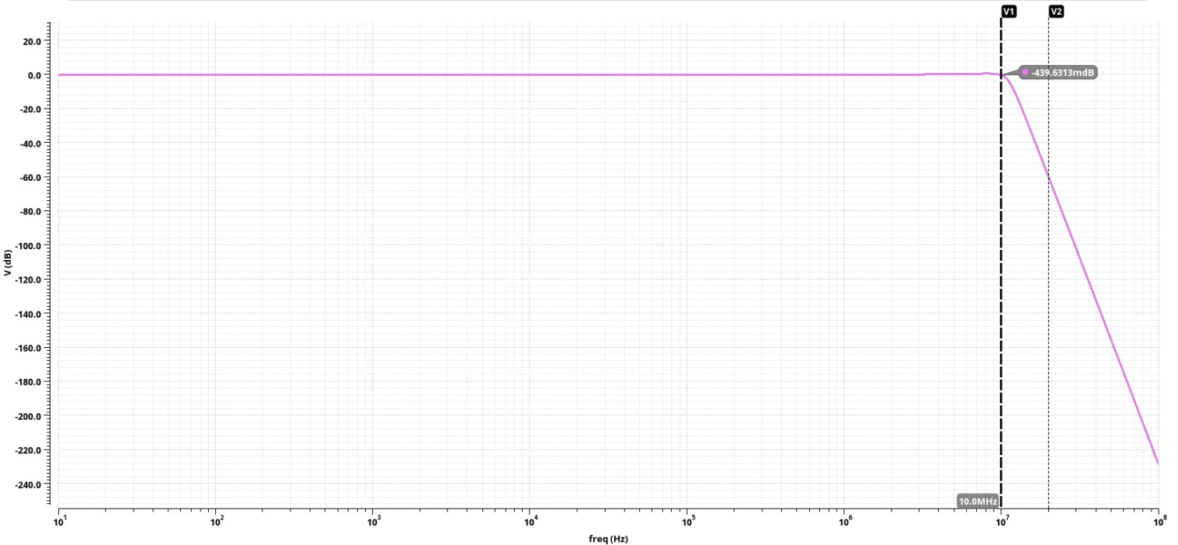
Waveform(α_{max}=-439.6313mdB)

